Slide 1
MedHiss: kick-off (WP)
Soutrik Banerjee

Slide 2
Health data
Claims data regarding diagnoses, consultations, hospitalisations, ER visits, investigations, mortality, ...
Sniir-AM (CNAMTS) claims data
Entire population having any claim are present
Available for the last 2 years only !
Covers almost all insurance schemes
Certain restrictions regarding search/query apply for confidentiality issues
Search/query at the French county level is allowed, especially for diseases, which are highly prevalent like cardio-respiratory illnesses
EGB (Échantillon Généraliste des Bénéficiares) Cohort created from the French medical insurance (CNAMTS) claims data for the wage earner
Representative of the French working population (or their families)
Randomly sampled from 1 out of 97 registered
Enrolees will be followed up for 20 years (starting from 2003)
Covers 80% of insurance schemes (more to be added later)

Slide 3

Sniir-AM
Diagnoses (ICD-10 code)
Socio-demographic data – age, gender, insurance type, county (“département”), commune, admission date, discharge date
Health care professional and health care institution data
Investigations, procedures, medical device
Pharmaceutical claims
Cost data
For more information, visit http://www.ameli.fr

Slide 4
EGB
Diagnoses (ICD-10 code)
Socio-demographic data – age, gender, insurance type, county (“département”), commune, admission date, discharge date
Health care professional and health care institution data
Investigations, procedures, medical device
Pharmaceutical claims
Cost data

Slide 5
EGB: limitations & caution
Limitations
Cause of death is not included (till date)
Overseas deaths are not recorded
Date of death stored for 27 months
No information on socio-economic status or behaviour (e.g., smoking)
Caution on sensitive data (list not exhaustive)
Commune
Day or month of birth (not year)
Day of any healthcare claim (not month or year)
Day of death (not month or year)
Hospital admission or discharge day (? month or year)
Note: This information cannot be matched one against another to obtain more refined data (e.g., matching the commune with birth month)

Slide 6
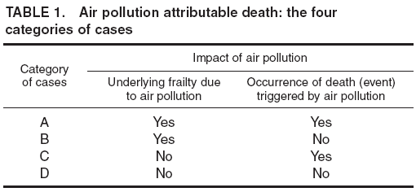
The present context
Measurement of health effects due to exposure to environmental hazards pose major challenges
Effects could be short-term (in days, weeks) or long-term or cumulative (in months, years, lifetime) [the latter more of interest in MedHis]
Künzli (2001) suggested 4 different plausible mechanisms in which air pollution could ultimately lead to ‘death’

Slide 7
Major challenges: Examples from air pollution
Short-term effects:
Typical exposures chosen are PM, Ozone, NO_{x} that are provided by the meteorological stations in urban locations
Which lag period to be selected? Gasparrini et al., Peng & Dominici suggest using Distributed Lag Model (DLM)
Which type of method to be used? Parametric or non-parametric (e.g., splines)?
Which model framework to be used? GLM or GAM?
Which splines to be used? Natural (cubic) or penalised B-splines?
How many degrees of freedom (i.e., smoothing parameter) to be chosen? A trade off between oversmoothing (bias) and undersmoothing (precision) is crucial
Should we aggregate the findings?
Finally, should we base our analysis on time-series analysis or case-crossover studies?

Slide 8
Major challenges
Long-term effects:
Which agents are causally associated to which outcomes?
How the agents interact to cause a health effect?
How cumulative exposure could be measured in the light of exposure misclassification?
Novel methods like marginal structural models (MLM), ... are suggested for lifetime risk assessment
Can traditional methods: 1 exposure → 1 outcome address the issue? – yes, but only partially
Exposures – which ones to measure? And what about unmeasured exposures?

Slide 9
Major challenges
Long-term effects:
In what way should we measure chemical exposures – direct method, indirectly through regression models, satellite images, portable sensors, cell phone applications, ...?
Exposures measured where? Outdoors or Indoors? Home, schools/offices, street?
Which exposures? PM, Ozone, Benzene, Toluene, Xylene, Formaldehyde, Acetaldehyde, Acrolein, CO, VOCs, NO_{x} ...?

Slide 10
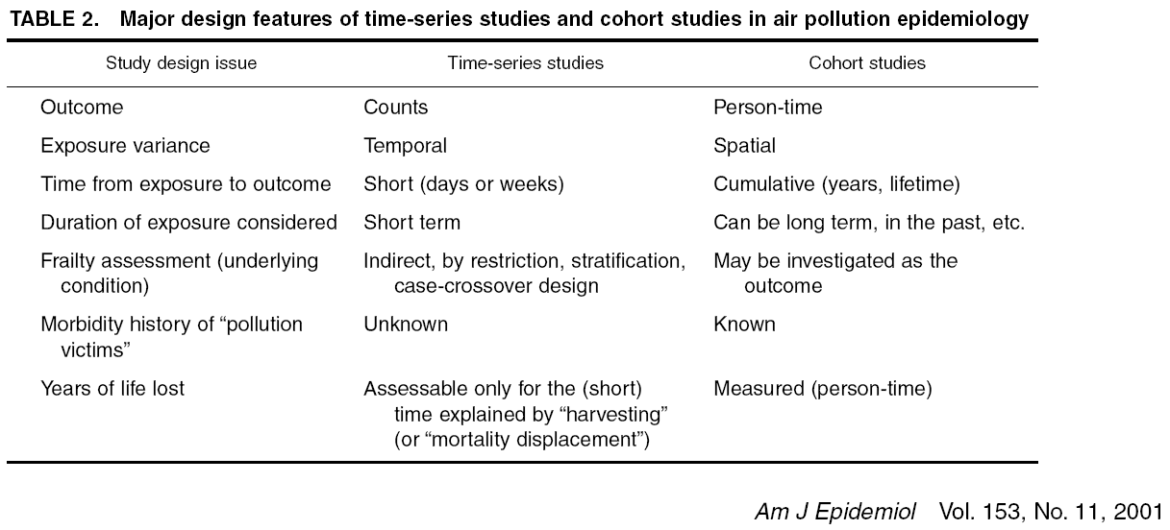
Short-term or long-term?

